Slide 1
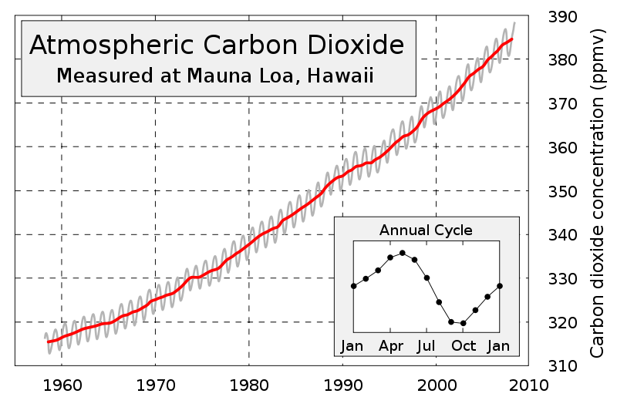
Lesson 2 Activity 31
What does the seasonal cycle on the Keeling Curve mean?
Notes:
Watch video: http://eoimages.gsfc.nasa.gov/images/globalmaps/data/mov/MOD17A2_M_PSN.mov
Do worksheet “what causes the seasonal trend in the keeling curve? before going on with ppt.
Then show slide 11 & 12.
This is a famous graph called the Keeling Curve. A scientist named Charles Keeling originally created this graph. Starting in the 1950s, Keeling studied levels of carbon dioxide in the atmosphere at Mauna Loa scientific observatory in Hawaii. Because it is located on an island in the middle of the Pacific Ocean, Mauna Loa is a great place to sample CO₂ in the atmosphere. The annual average CO₂ that is measured represents the entire globe, but Hawaii is located about 1300 miles north of the equator, and is thus also influenced by seasonal patterns of the Northern Hemisphere.

Slide 2
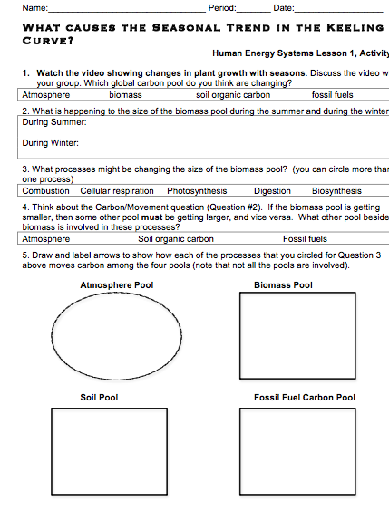
Student Instructions
Complete the worksheet “What Causes the Seasonal Cycle in the Keeling Curve?”

Slide 3
1. The Location Question: Where are the available pools of carbon in our environment? What pools of materials are they in?
2. The Carbon/Movement Question: How/Why do carbon pools change over time? How are carbon atoms moving?
3. The Energy Question: How does energy flow through environmental systems?
Notes:
Can you answer these questions to explain the seasonal trend in the Keeling curve?

